Slide 1



Sell Your Smart Contract
Cohort 3
DECK — V.01.1
Trustless Escrow for Smart Contracts
Notes:
Smart contracts on public blockchains are enabling individuals and organizations to sell on-chain products and services.
Many, if not most, of these organizations are not publicly traded, meaning they do not have an ERC-20 token or an on-chain DAO treasury, that accrues revenue.
However, they do have a wallet that owns the smart contracts for their products. private transactions.

Slide 2
No Trustless Exchange of Privately Owned Smart Contracts
Niche, but rapidly growing market for private transactions on public blockchains.
Use Case | Examples | Description
DAO Lending | Debt DAO | Loans are automatically repaid by borrowers.
Programmable Cash Flows | Superfluid | Subscriptions, salaries, rewards, etc.
DAO Mergers and Acquisitions | DAOHaus | DAO transfers ownership of smart contract in exchange for tokens.
Indexes and ETFs | TokenSets, Index Coop | Decentralized ETFs and indexes accrue streaming fees.
Creator Royalties & Bonds | Royalty Agreements | Creators sell all or a portion of the royalty streams from their works for upfront cash payments.
Trustless Escrow for Smart Contracts
Notes:
Unfortunately, there is no existing solution that enables trustless private market transactions on public blockchains. How do individuals and businesses exchange smart contracts that own revenue streams for fixed or lump sum payments?

Slide 3
Escrow Dapp for Private Smart Contract Transactions
Trustlessly exchange privately owned smart contracts for fixed or lump sum payments.
Liquidity for builders and creators.
New opportunities for investors.
Eliminate investment banker and legal fees (see Twitter acquisition).
Reduce transaction closing times.
Trustless Escrow for Smart Contracts

Slide 4

Demo
Trustless Escrow for Smart Contracts

Slide 5
Roadmap
Different types of smart contracts beyond OpenZeppelin’s Ownable.
Multisignature and smart contract wallets.
Marketplace of buyers and sellers.
Monetize transactions.
Deploy to Ethereum Mainnet!
Trustless Escrow for Smart Contracts

Slide 6
Resources
Whitepaper
GitHub
Trustless Escrow for Smart Contracts

Slide 7







Contact Team
Thomas Hepner
Shreya Radesh
Erik Hanchett
Kahaan Patel
Jason Shi
Trustless Escrow for Smart Contracts

Slide 8
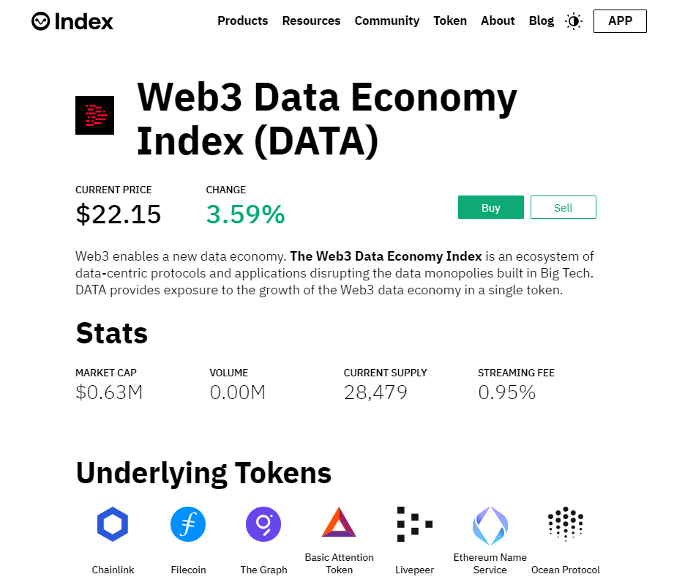
Origin
$DATA is a decentralized ETF on Ethereum.
Simple, 1-click exposure to 8 tokens.
Manager earns 95 bps annual streaming fee.
How to sell rights to recurring revenue stream and transfer ownership?
Trustless Escrow for Smart Contracts

